Slide 1
FixMatch: Simplifying Semi-Supervised Learning with Consistency and Confidence Kihyuk Sohn, David Berthelot, Chun-LiangLi Google Search 2020, Neural Information Processing Systems

Slide 2








Overview
Main Idea: Combined consistency regularization & pseudo-labeling.
CR: Perturbed versions results in same predictions.
Pseudo-labeling: Hard labels(arg max of the outputs).
$𝒳$= $\left\{\left(x_{b},p_{b}\right):b∈(1,…B)\right\}$
A batch of $B$ labeled examples
$𝒰$= $\left\{u_{b}:b∈(1,…μB)\right\}$
A batch of $μB$ unlabeled examples
$$p_{m}(y|x)$$
Prediction distribution of input x
$$H(p,q)$$
Cross Entropy between $p$ and $q$
$$𝒜\left(∙\right), α\left(∙\right)$$
Strong augmentation, week augmentation

Slide 3
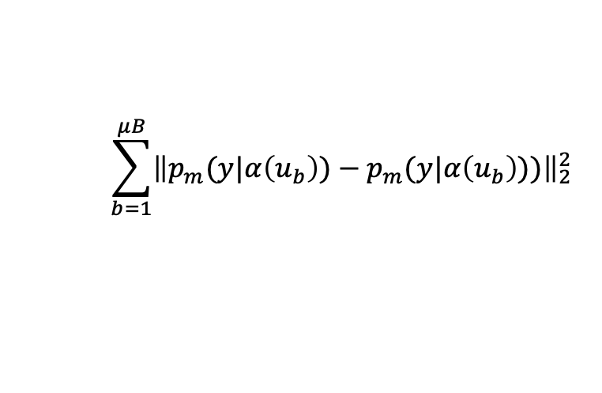
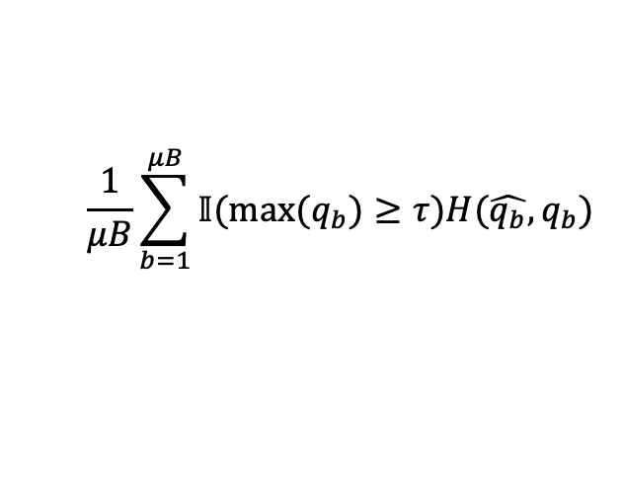
Background
Pseudo-labeling : Using model itself to obtain artificial labels.
Letting $q_{b}=p_{m}\left(y | u_{b}\right)$ and $\hat{q_{b}}=argmax(q_{b})$,then loss function is like:
$$\frac{1}{μB}\sum_{b=1}^{μB}{𝕀(max⁡(q_{b})≥τ)H(\hat{q_{b}},q_{b}) }$$
CR: Perturbed versions results in same predictions. The loss function is like:
$$\sum_{b=1}^{μB}{{\left\|p_{m}(y|α\left(u_{b}\right))−p_{m}(y|α\left(u_{b}\right)))\right\|}_{2}^{2}}$$

Slide 4
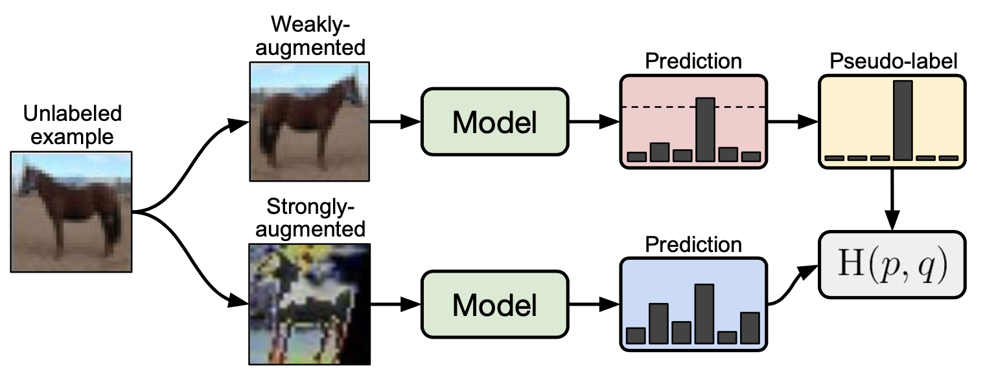
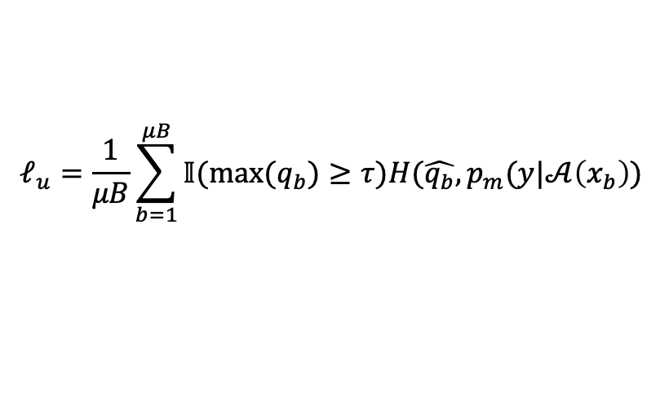
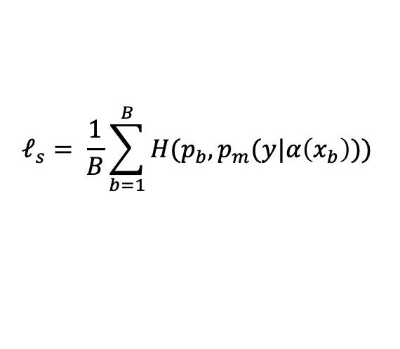
FixMatch Algorithm
Loss: A supervised loss $ℓ_{s}$ and an unsupervised loss $ℓ_{u}$ .
$$ℓ_{s}= \frac{1}{B}\sum_{b=1}^{B}{H(p_{b},p_{m}(y|α\left(x_{b}\right))) }$$
$$ℓ_{u}=\frac{1}{μB}\sum_{b=1}^{μB}{𝕀(max⁡(q_{b})≥τ)H(\hat{q_{b}},p_{m}(y|𝒜\left(x_{b}\right)) }$$
Total loss $ℓ_{t}=ℓ_{s}+$ ${λ_{u}ℓ}_{u}$.

Slide 5
Augmentation in FixMatch
Weak: Simple flip-and shift.
Strong: CutOut + AutoAugmentation.
RandAug: Randomly select M types and with a fixed magnitude.
CTAAug: Randomly select M types and with a magnitude can be learned.

Slide 6
Additional important factors in FixMatch
Regularization.
Optimization Algorithm : SGD is better than Adam.
Learning Rate : $η\cos\left(\frac{7πk}{16K}\right)$

Slide 7
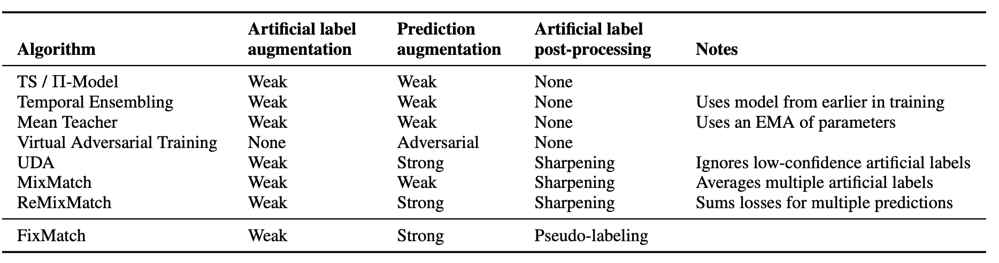
Benchmark of SSL

Slide 8
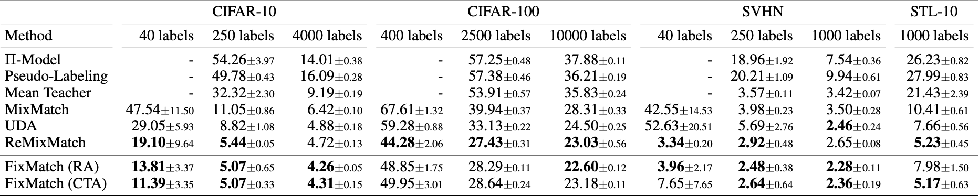
Experiments

Slide 9
Barely Supervised Learning Study
Main idea: Only one example per class.
Method: Create 4 datasets by randomly selecting one example per class.
Conclusion: Inner-dataset variance is much more lower.
Assumption: Data quality.

Slide 10
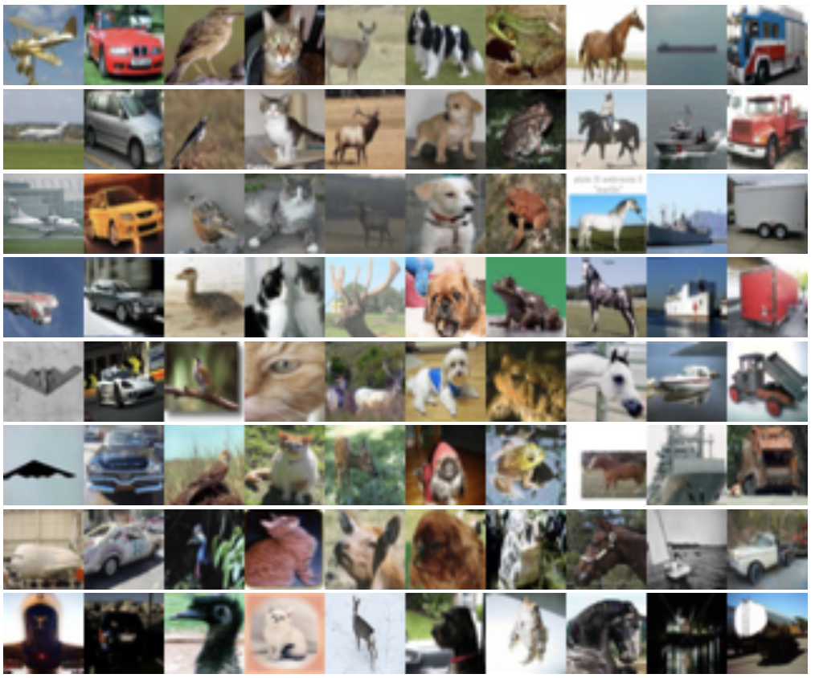
Barely Supervised Learning Validation
Main idea: Divided into 8 buckets(high-to-low).
Reaches 78% accuracy.
Reaches 65% accuracy.
Reaches only 10% accuracy.

Slide 11
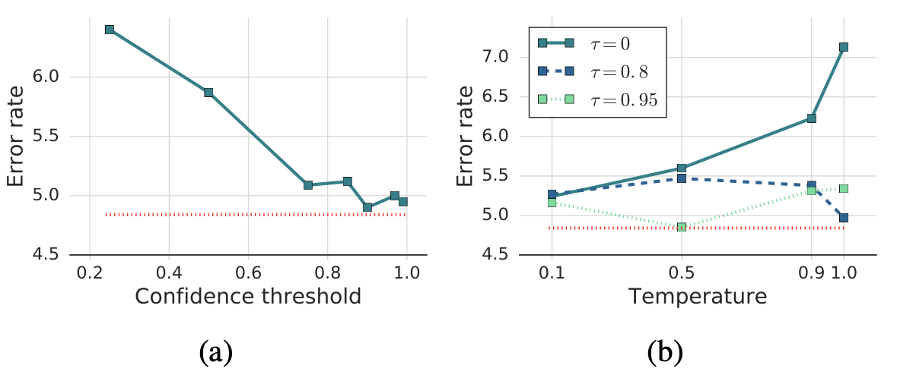
Ablation Study-sharpening and thresholding
Conclusion: Sharpening results in a new para but no better performance.
Threshold 0.95 is the best.

Slide 12
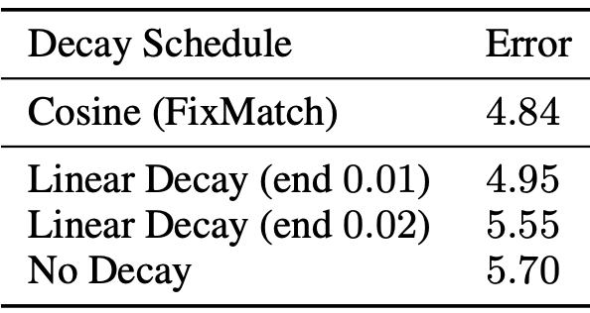
Ablation Study- learning rate decay

Slide 13
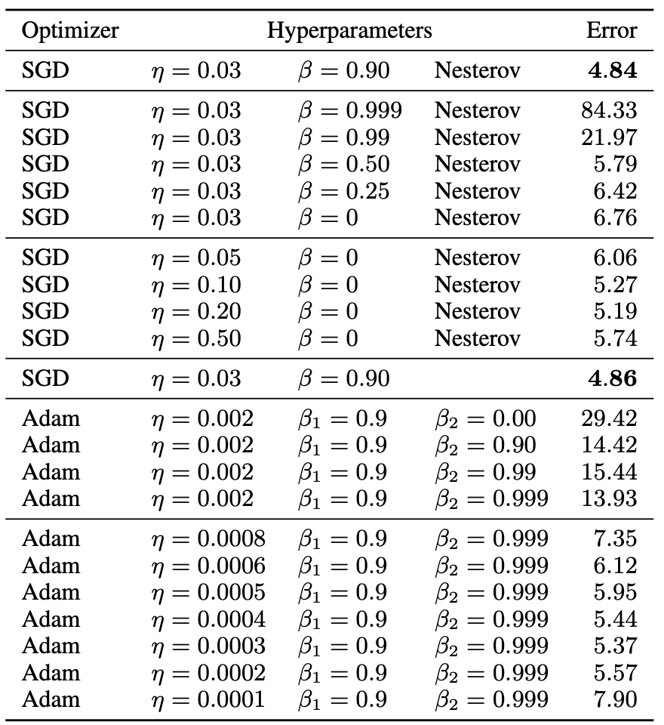
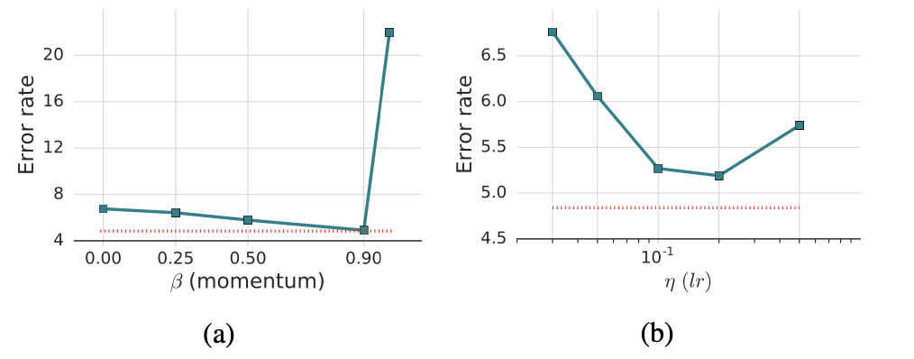
Ablation Study- Optimizer

Slide 14
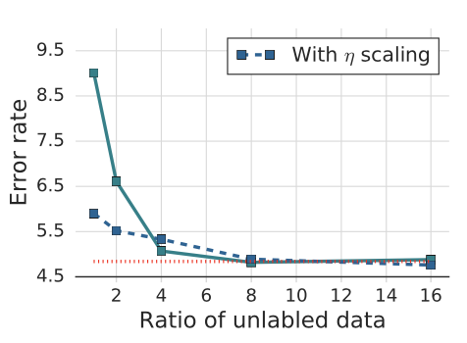
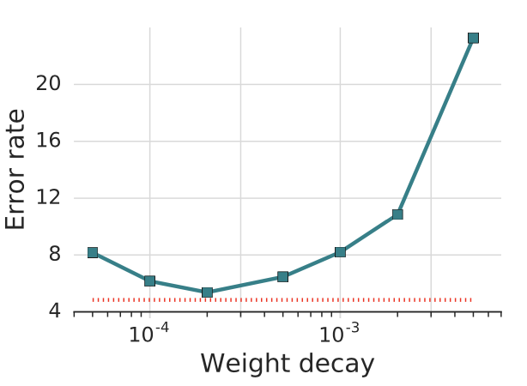
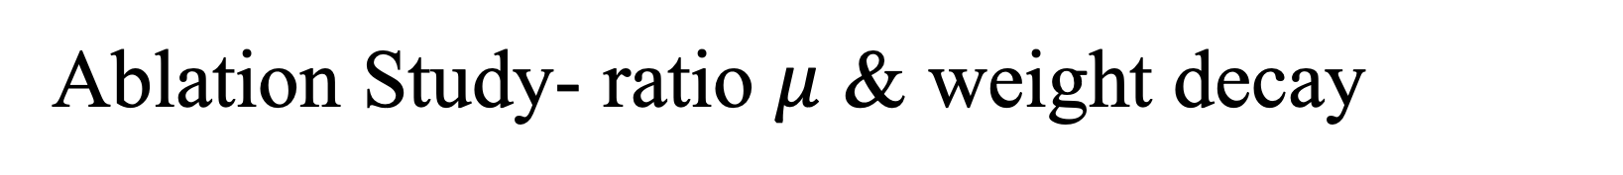
Ablation Study- ratio $μ$ & weight decay

Slide 15
Conclusion
Advantages:
1.Simple and able to thoroughly investigate how it works.
2.Great performance
Disadvantages:
1.不适合分割,会损坏细节信息.
2.强数据增强部分对与灰度图不适用.
Code: https://github.com/google-research/fixmatch

Slide 16
Thank you (Q&A)
Notes:
RP Shortcomings：1.relative position has multi result. 2.CNN learn trivial features. 3. not whole picture.

